Slide 1
Math Expressions in Use!!
Presented by:
Kelly Robbins
East China Schools, 4th Grade Teacher

Slide 2
Uses in My Room
Bell Work/Remembering Sheets
Math Fluency
Class Work – Homework
Math Talk
Quick Quizzes & Fluency Checks
Performance Tasks
Assessments & Retakes
Weekly Newsletter
Class Website
Think Central Website –(Teacher Guide, Student Text, Mega Math)

Slide 3
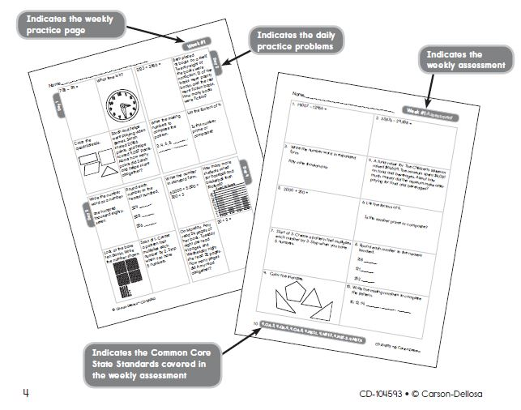
Bell Work/ Remembering Sheets
I also use Remembering sheets during tutoring time. I assign a page for review and when they finish they can go on Mega Math. It is our catch up time and get ready for the assessment time.

Slide 4
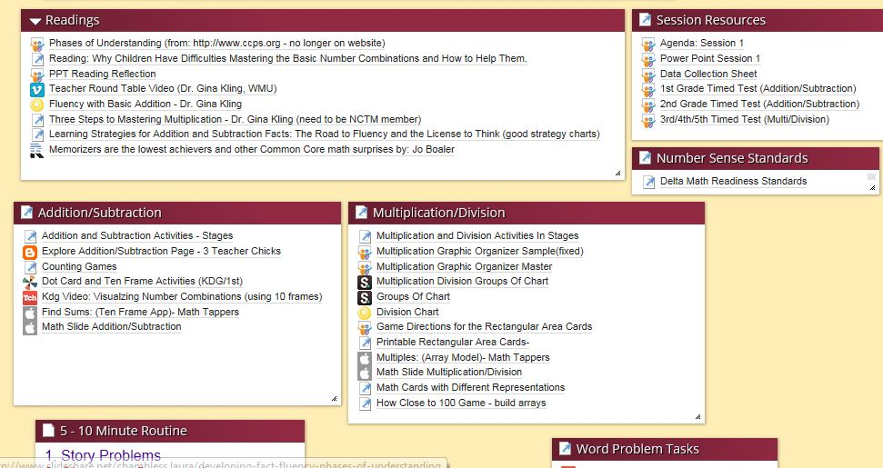
Math Fluency
http://www.protopage.com/lchambless#Professional/Basic_Fact_Fluency

Slide 5
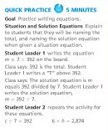
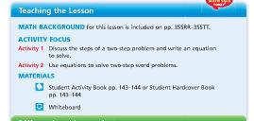
Class work & Homework
Quick Practice – first 5 mins.
Do each lesson, might not be
on homework but will show up
in Quick Quiz and/or Assessments

Slide 6
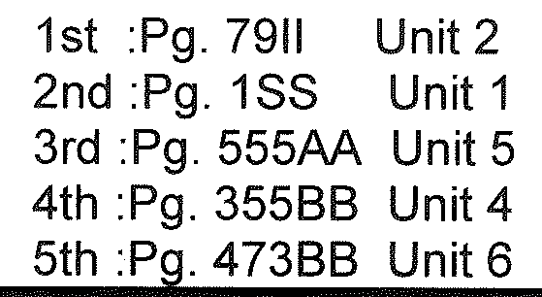
Math Talk
http://www.eduplace.com/math/mthexp/pdf/mathtalk.pdf
The NCTM Standards emphasize the importance of developing mathematical language and communication in order to understand concepts rather than merely following a sequence of procedures.
Level 1, 2 and 3 explanations are found in the Getting Ready to Teach problem solving units.
Kagan Strategies

Slide 7
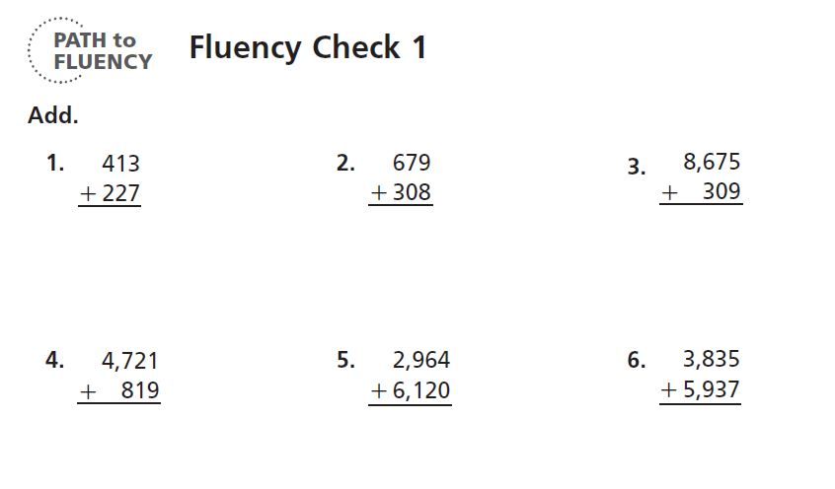
Quick Quizzes & Fluency Checks
I copy them back to back and give them about 45 minutes to complete. Use as quiz grades.

Slide 8
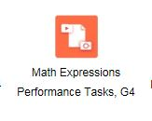
Performance Tasks
This past year new ones were released, they are available online at Think Central website under Resources
They are available for
K-5.

Slide 9
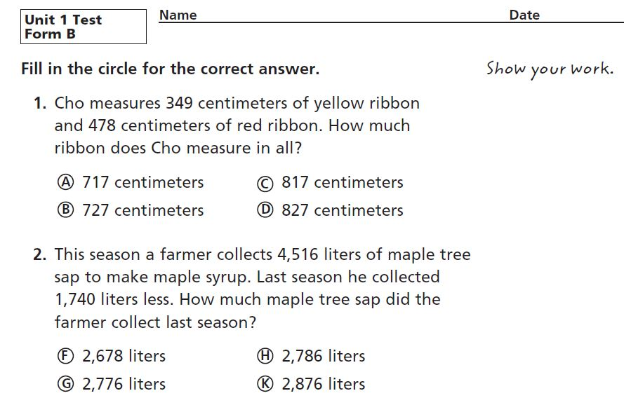
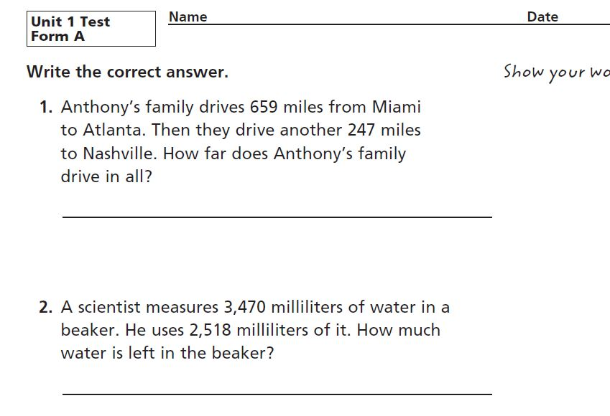
Assessments & Retakes
Form A or Form B (multiple choice)
We retest in our district. The Math Committee wrote retakes, new and reduced number of questions. They are similar to Form A.

Slide 10
Weekly Newsletters
To help with Parent Education and Communication, I wrote a weekly newsletter to help explain methods associated with Math Expressions, i.e. math mountains, place value sections model, etc.

Slide 11
Class Website Uses
Links to PDF for
flashcards,
homework sheets,
videos,
instructions for Think Central and Mega Math games appropriate for each chapter/lesson
Daily work/assignments agenda
Math News newsletter
www.ecsd.us/staff/krobbins will be changing to www.mrskellyrobbins.weebly.com

Slide 12
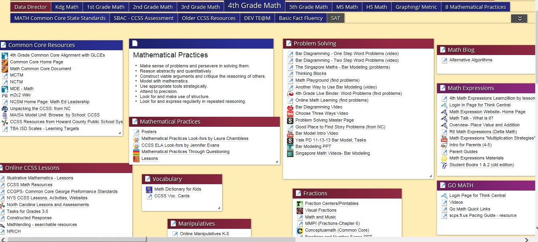
Laura Chambless Assistant Director, K-7 Science and Math, St. Clair RESA
http://www.protopage.com/lchambless#Professional/4th_Grade_Math
Further resources for Math Expressions: http://moodle.sccresa.org/

Slide 13
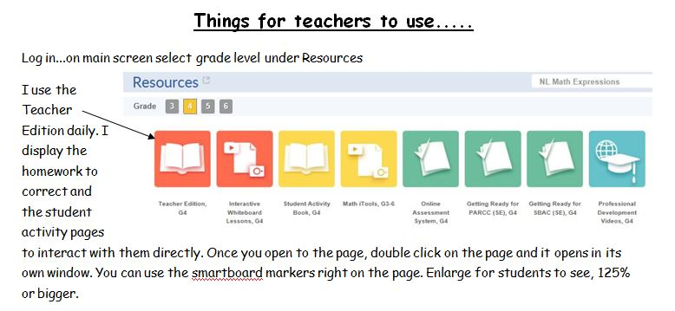
Think Central Website
https://www-k6.thinkcentral.com

Slide 14
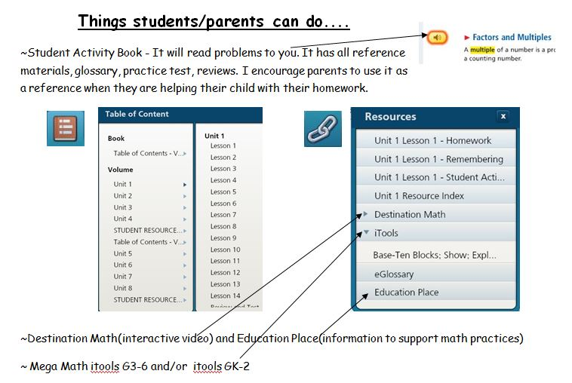
Parent & Student Uses

Slide 15
Thank you for attending!!! Please feel free to contact me at anytime. krobbins@ecsd.us 810-676-1190
I have not used the Assignments or Reports areas or mySmartPlanner, but if anyone would like to share their experience with this they are welcome too!

